Slide 1
Is Your Neighborhood Fat?
Jonathan Toro

Slide 2
Why should we care about the obesity rate?
High blood pressure
Type 2 diabetes
Coronary heart disease (America’s biggest killer!)
Clinical Depression
Stroke

Slide 3
CHSI County Data Set
Demographics
Environmental Health
Leading Causes of Death
Relative Health Importance
Preventive Services Use
Risk Factors and Access to Care

Slide 4
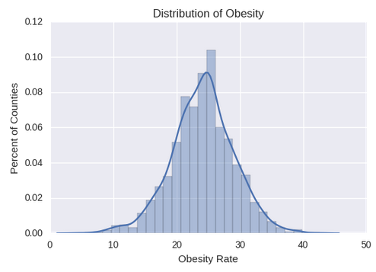
Visualizing Obesity Rates

Slide 5
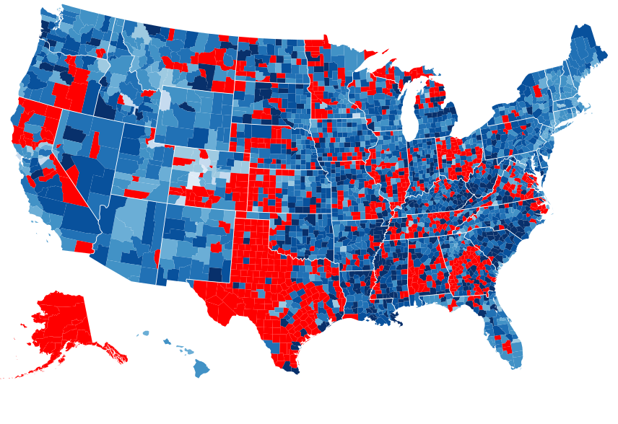

Slide 6
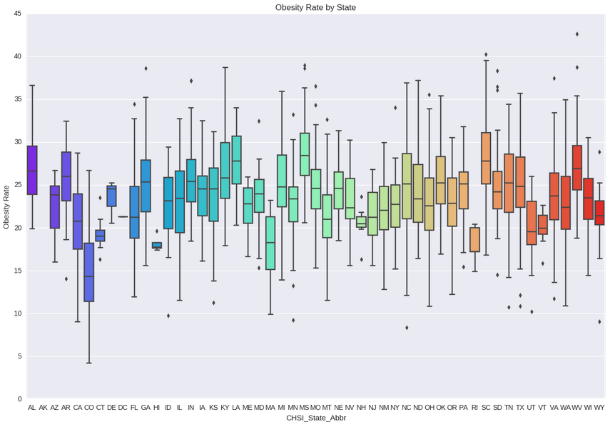

Slide 7
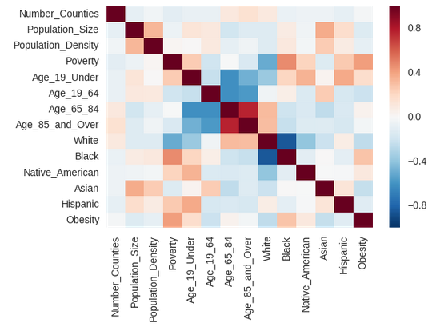
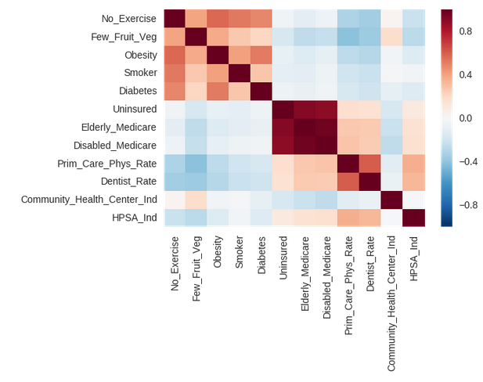
Interesting Observations

Slide 8
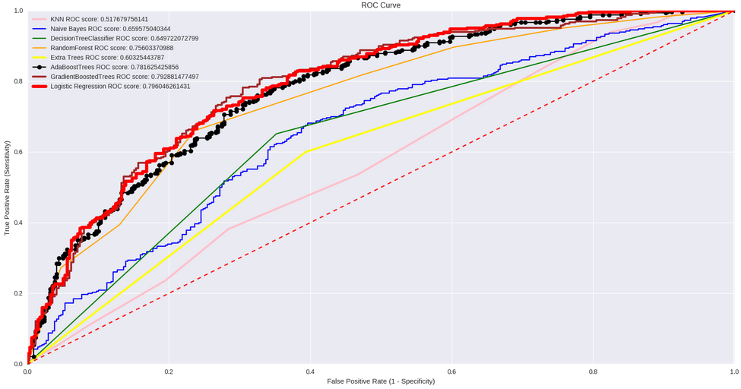
Most Important Features
No Exercise
Diabetes
Few Fruit and Vegetables
Primary Care Physician Rate
Poverty
Black
Age 19-64
Dentist Rate
Asian
Toxic Chemicals
Recent Drug Use
Females with Heart Disease
Age 19 under
White
Major depression

Slide 9
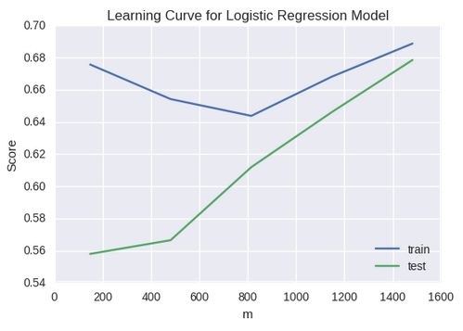
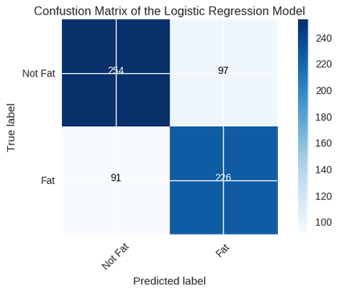
Logistic Regression Wins!

Slide 10
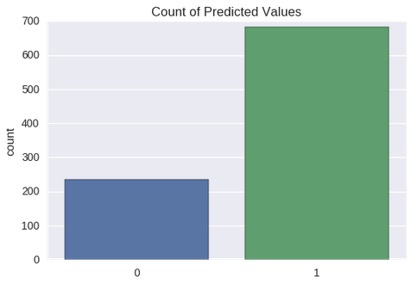
Surprising Results

Slide 11
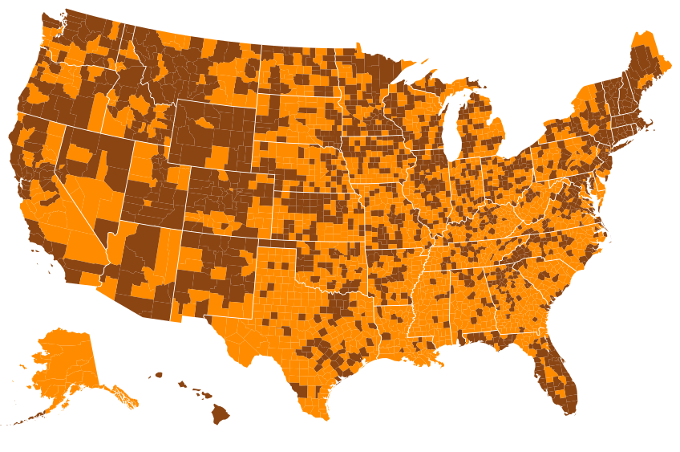
Fat
Not Fat

Slide 12
Conclusions
Obesity is evident throughout all of America
A possible way to fight obesity is to educate people younger than 19 years about exercise and diet
Race and culture affects the chance of being obese
Midwest has the highest concentration of lower obesity rates

